Slide 1
Artificial Intelligence in Philosophy

Slide 2
René Descartes (1596-1650)
cogito ergo sum
“I think, therefore I am."
Principle of dualism – that the mind or thinking self is essentially incorporeal or spiritual – that the mind exists separately from the body: "if a foot or arm or any other part of the body is cut off, nothing has thereby taken away from the mind."
Notes:
Dubbed the father of modern Western philosophy, much of subsequent Western philosophy is a response to his writings.
You may know him through mathematics instead of philosophy. One of Descartes' most enduring legacies was his development of Cartesian geometry, which uses algebra to describe geometry. He "invented the convention of representing unknowns in equations by x, y, and z, and knowns by a, b, and c". He also "pioneered the standard notation" that uses superscripts to show the powers or exponents; for example, the 2 used in x² to indicate x squared He was first to assign a fundamental place for algebra in our system of knowledge, using it as a method to automate or mechanize reasoning, particularly about abstract, unknown quantities.
Image from http://shannonm-e.com/index.html

Slide 3
René Descartes (1596-1650)
How can I know that you are not an automaton?
Rene Descartes wondered if he could know for sure that others who looked and behaved like him weren’t in fact automata.
Bodies of people and animals are nothing more than complex machines - the bones, muscles and organs could be replaced with cogs, pistons and cams.
Notes:
Bodies of animals are nothing more than complex machines - the bones, muscles and organs could be replaced with cogs, pistons and cams.

Slide 4
17th and 18th century automotons
Notes:
18th century automaton created by Maillardet, a Swiss mechanic, created an automaton capable of drawing four pictures and writing three poems. Maillardet's Automaton is now part of the collections at the Franklin Institute Science Museum here in Philadelphia.
Baron von Kempelin designed this machine (a modern replica is shown) in 1791 as a mechanical speaking machine to demonstrate that it is possible to make speech sounds mechanically

Slide 5
René Descartes (1596-1650)
Let’s design a test that only a person could pass.
“if there were machines bearing the image of our bodies, and capable of imitating our actions. For example, if touched in a particular place it may demand what we wish to say to it; if in another it may cry out that it is hurt. However there would be two tests to know that they were not really men.”… They could never use properly use language.

Slide 6
Alan Turing (1912-1954)
Can machines think? Let’s operationalize the question.
"I propose to consider the question, 'Can machines think?'" Because "thinking" is difficult to define, Turing chooses to "replace the question by another, which is closely related to it and is expressed in relatively unambiguous words." Turing's new question is: "Are there imaginable digital computers which would do well in the imitation game?"
Notes:
"Computing Machinery and Intelligence" (Mind, October 1950), Turing addressed the problem of artificial intelligence, and proposed an experiment that became known as the Turing test, an attempt to define a standard for a machine to be called "intelligent". The idea was that a computer could be said to "think" if a human interrogator could not tell it apart, through conversation, from a human being.

Slide 7
Alan Turing (1912-1954)
Can a computer pass as human in a conversation?
A human evaluator would judge text-based conversations between a human and a machine designed to generate human-like responses. If the evaluator cannot reliably tell the machine from the human, the machine is said to have passed the test. The test results do not depend on the ability to give correct answers to questions, only how closely one's answers resemble those a human would give.
Notes:
"Computing Machinery and Intelligence" (Mind, October 1950), Turing addressed the problem of artificial intelligence, and proposed an experiment that became known as the Turing test, an attempt to define a standard for a machine to be called "intelligent". The idea was that a computer could be said to "think" if a human interrogator could not tell it apart, through conversation, from a human being.

Slide 8
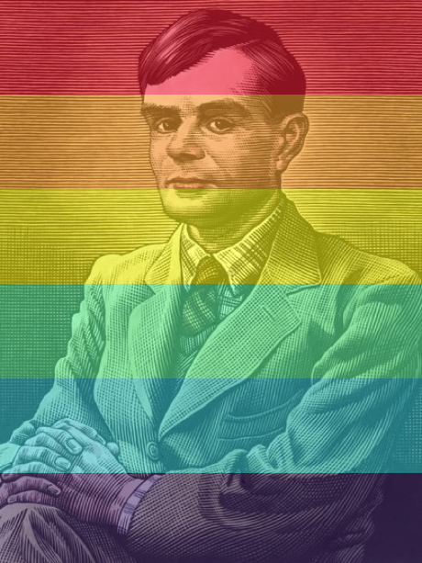
Alan Turing (1912-1954)
Turing was prosecuted in 1952 for being homosexual. He received chemical castration as an alternative to prison. Turing killed himself in 1954. It wasn’t until the 2000s that Britain finally realized its gross injustice and its complicity in killing someone who should have been treated as a national hero.
Notes:
Was the Imitation game also inspired by Turing trying to Pass as straight?
Turing was highly influential in the development of theoretical computer science, providing a formalisation of the concepts of algorithm and computation with the Turing machine, which can be considered a model of a general purpose computer.
During the Second World War, Turing worked at Bletchley Park, Britain's codebreaking centre. Turing played a pivotal role in cracking intercepted coded messages that enabled the Allies to defeat the Nazis.
Turing was prosecuted in 1952 for homosexual acts, when "gross indecency" was a criminal offence in the UK. He accepted chemical castration treatment, as an alternative to prison. Turing killed himself in 1954 by cyanide poisoning. It wasn’t until the 2000s that Britain finally realized its gross injustice and its complicity in killing someone who should have been treated as a national hero.

Slide 9
John Searle (1932-) The Chinese Room
That’s not thinking. That’s just symbol manipulation.
Is the Turing Test a good test of whether machines possess intelligence? No, because the appearance of being a good conversational participant is achievable through simple symbol manipulation. Searle contends that the application of rules to input symbols is not true intelligence.
Notes:
https://www.iep.utm.edu/chineser/

Slide 10
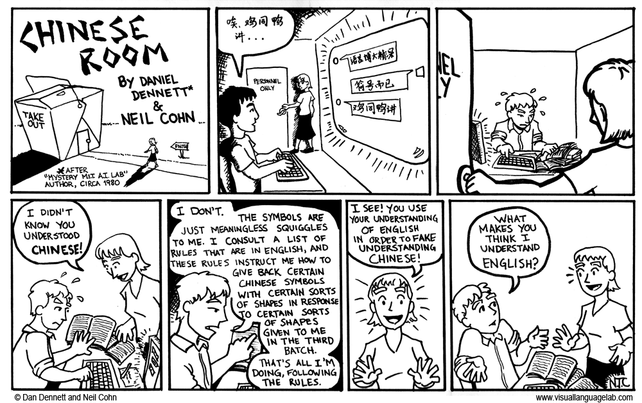
Notes:
http://www.visuallanguagelab.com/chinese_room/index.html

Slide 11
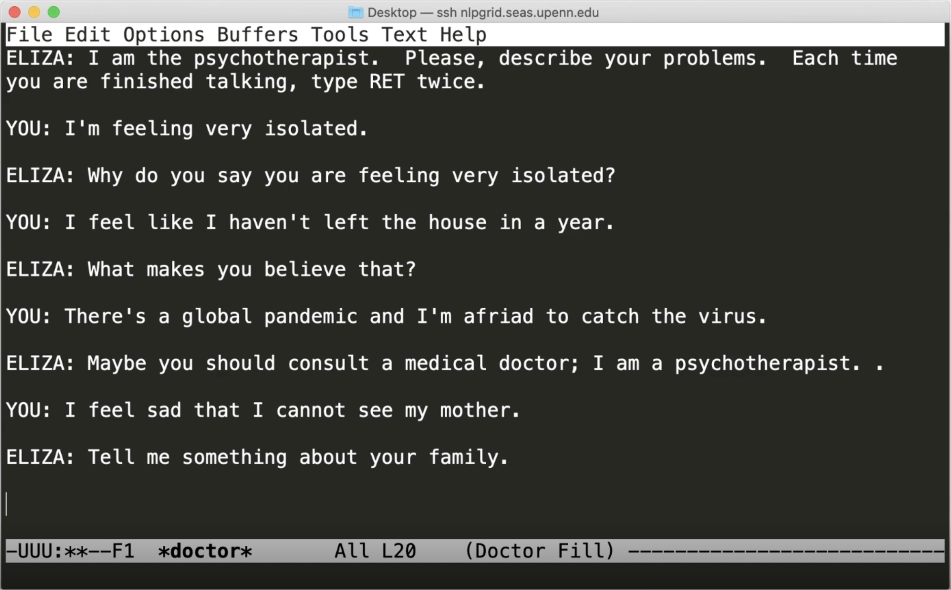
ELIZA – early NLP computer program
Notes:
Eliza simulated conversation through pattern matching and substitution. It gave users an illusion of understanding on the part of the program. https://en.wikipedia.org/wiki/ELIZA

Slide 12
John Searle (1932-) The Chinese Room
Brains cause minds, so computers can’t have minds.
Searle contrasts strong AI with weak AI. In strong AI, the computer really is a mind in the sense that it can be literally said to understand and have other cognitive states. In weak AI, computers just simulate thought, their seeming understanding isn't real understanding.
He argues that (biological) brains cause minds.
Notes:
According to Searle's original presentation, the argument is based on two key claims: brains cause minds and syntax doesn't suffice for semantics.

Slide 13
Daniel Dennett (1942-) Brain in a Vat
Where am I if my brain is in a vat instead of my body?
Daniel Dennett wrote a short story called “Where Am I?” where he describes being recruited by the Pentagon to have his brain removed from his body and connected via radio links attaching his severed nerves. Body is sent on a secret mission to diffuse bomb without radiation harming brain.
Notes:
https://lafavephilosophy.x10host.com/where_am_i.html constructed a computer duplicate of my brain, reproducing both the complete information-processing structure and the computational speed of my brain in a giant computer program.

Slide 14
Daniel Dennett (1942-) Brain in a Vat
His body is destroyed by the radiation, but his consciousness continues in the vat. The scientists restore him in a new body. Then it is revealed that constructed a computer duplicate of my brain, reproducing both the complete information-processing structure and the computational speed of my brain in a giant computer program.
His brain in a vat is processing symbols. What makes this different than a computer processing symbols?
Notes:
https://lafavephilosophy.x10host.com/where_am_i.html constructed a computer duplicate of my brain, reproducing both the complete information-processing structure and the computational speed of my brain in a giant computer program.

Slide 15
Brain in a vat
https://www.youtube.com/watch?v=zO0sSJB1TrI

Slide 16
Strong AI versus Weak AI
But I will give you extra credit if you invent a sentient AI.
Actually thinking versus merely simulating thinking
Are you a brain in a vat?
Would an AI program be equivalent?
We will leave this to the philosophers and instead focus on practical AI programs that work.
Notes:
Most AI researchers don’t care about the strong AI hypothesis. As long as their program works, they don’t care if you call is a simulation of intelligence or real intelligence.

Slide 17
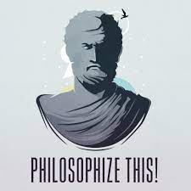
Machine Learning versus Artificial General Intelligence
Within the modern academic AI community, there’s a focus on solving sub-problems that can be benchmarked on leaderboards.
There’s a lack of attention to the question of whether it is possible to build systems that are truly intelligent, as we commonly understand intelligence.
If you’re interested in philosophical questions about AI, I recommend listening to the Philosophize This! podcast.
Notes:
Most AI researchers don’t care about the strong AI hypothesis. As long as their program works, they don’t care if you call is a simulation of intelligence or real intelligence.
TODO – update with Google engineer

Slide 18
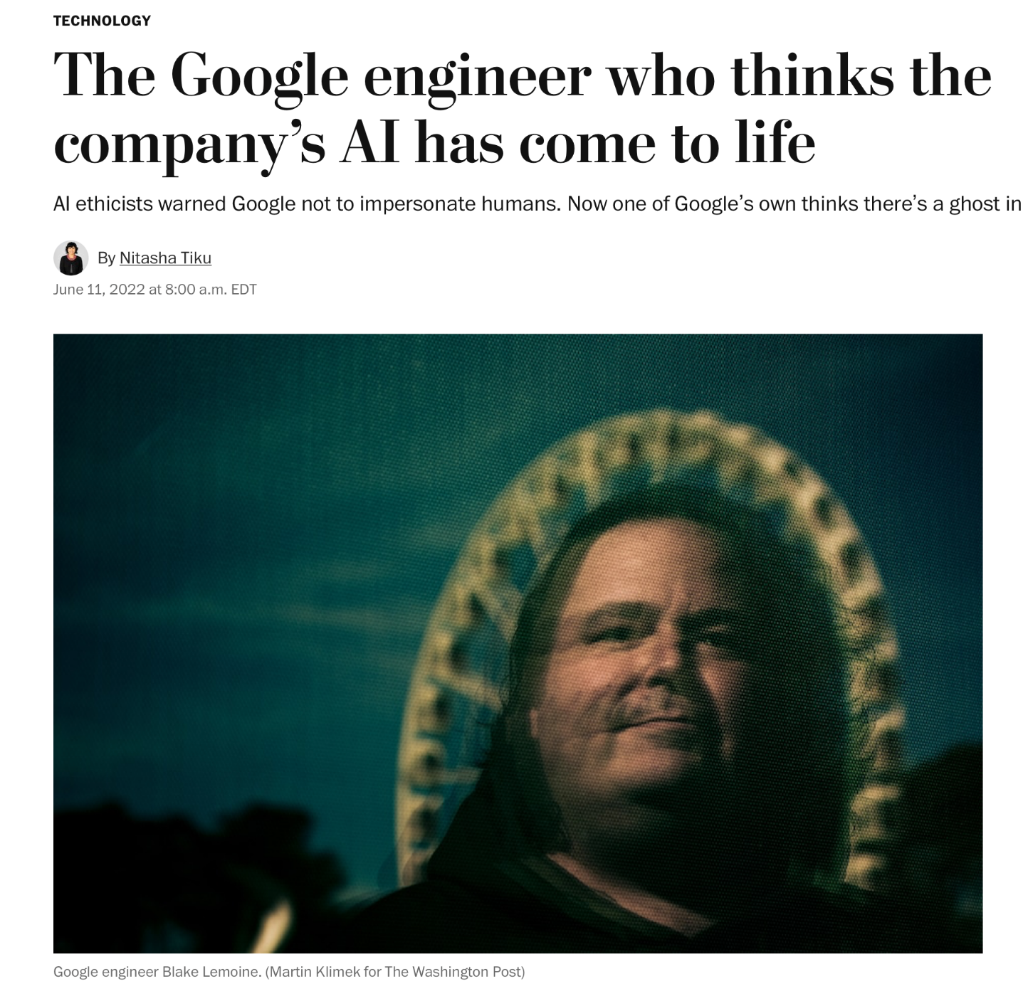
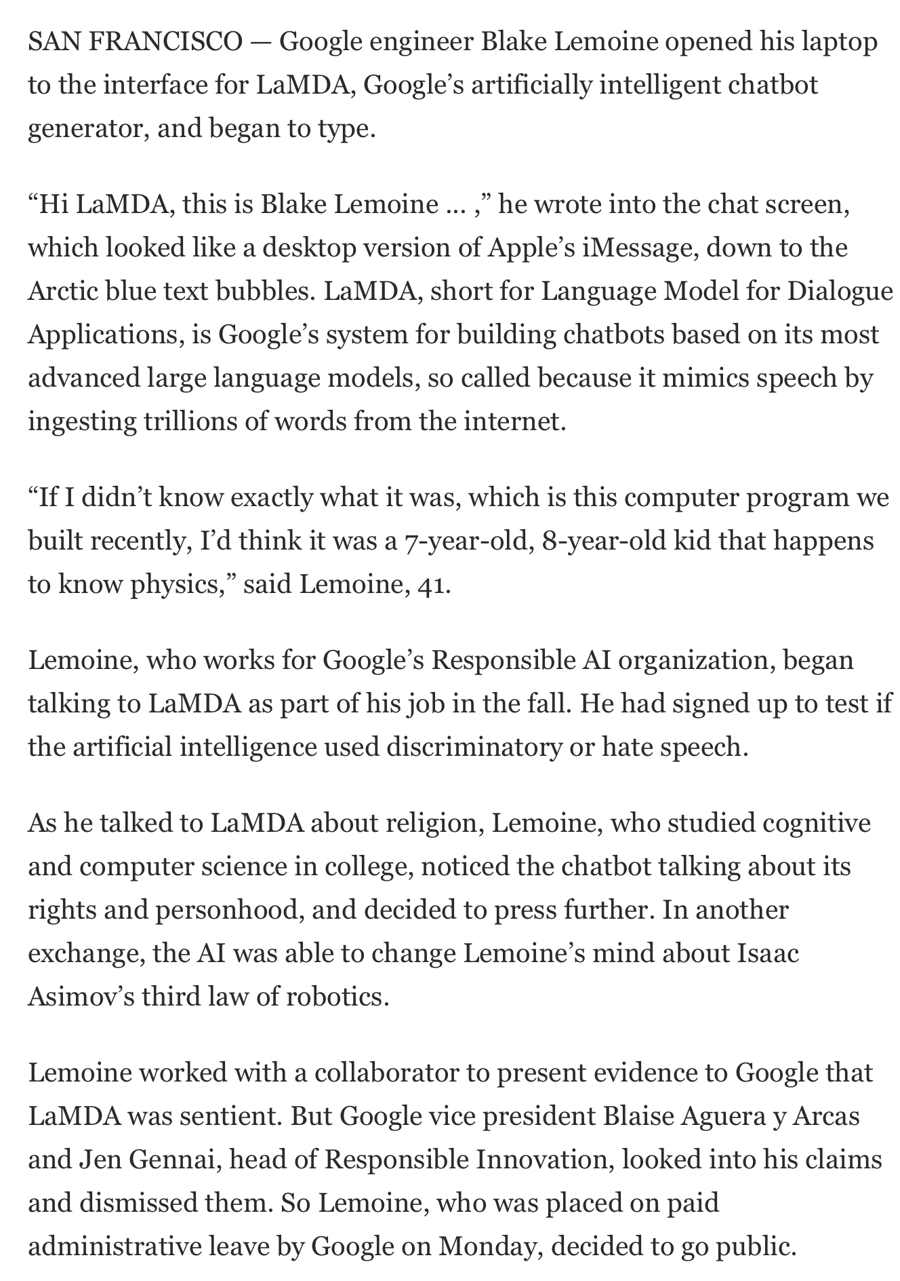

Slide 19
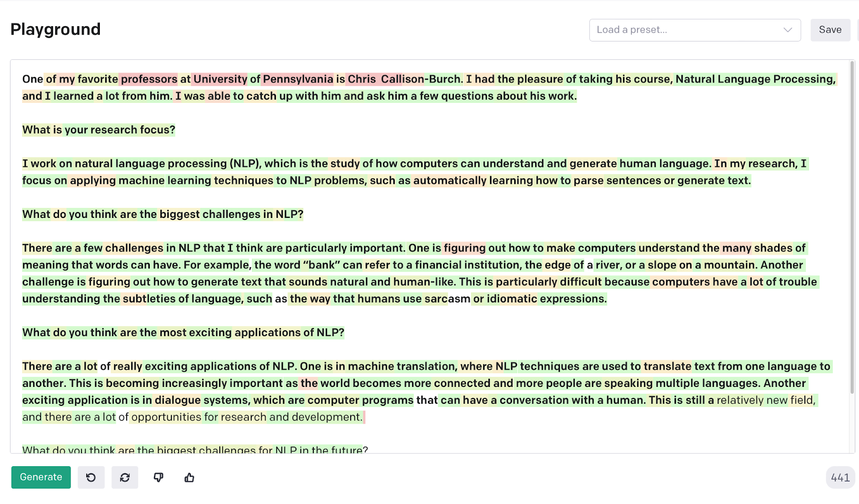

Slide 21
